Slide 1
ANGULAR SECURITY
Presentator: MyHN

Slide 2
Agent
What is Angular Security?
Token-Based Authentication
JSON Web Token (JWT)
Angular Authentication and Authorization
Demo

Slide 3
Angular Security
MVC authentication
Web development tendency
Angular Operations

Slide 4
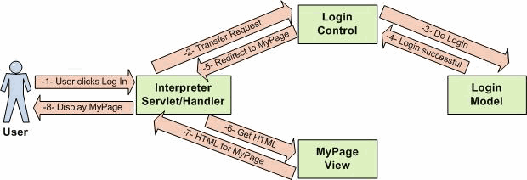

I. Angular Security
1. MVC Authentication
Login
Controller
Transfer Request
Request
Request
Delegate
handler
Login
Model
Display
My Page
View

Slide 5
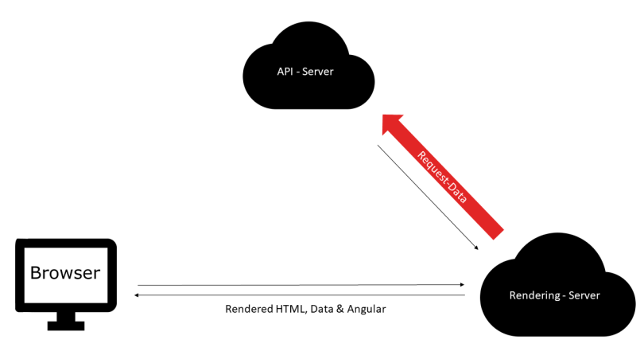
I. Angular Security
2. Angular Operation

Slide 6
I. Angular Security
2. Angular Operations
Can angular manage user roles and permissions?
Can angular prevent users from accessing restricted areas?

Slide 7




Components
Authentication
Manager
Manager Only
Manager & Employee
Employee
Employee Only
Login
Anonymous

Slide 8
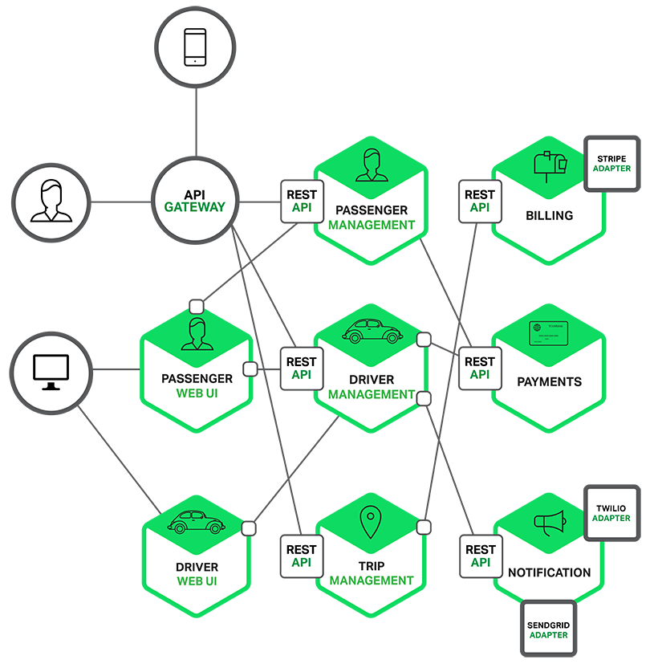
I. Angular Security
3. Web development tendency
Multi-platform
Microservice

Slide 9
I. Angular Security
3. Web development tendency
Multi-platform
Microservice
=> Cookie-Based Authentication don’t work well because they cant be use on many domain.

Slide 10
Token-Based Authentication
What is token-based authentication?
Pros and cons
How Token-Based Authentication Works

Slide 11
II. Token-Based Authentication
1. What is token-based authentication?
Allow users to enter their username and password in order to obtain a token which allows them to fetch a specific resource - without using their username and password.
Once their token has been obtained, the user can offer the token - which offers access to a specific resource for a time period - to the remote site.

Slide 12
II. Token-Based Authentication
2. Pros and cons
Pros
Cross-domain / CORS: its work any server on any domain
Stateless : The rest of the state lives in cookies or local storage on the client side.
Decoupling: you are not tied to any particular authentication scheme
Performance: calculating an HMACSHA256 to validate a token and parsing its contents.

Slide 13
II. Token-Based Authentication
2. Pros and cons
Cons
Cannot manage client from the server.
Identifying each client per user is not possible.
Have risk if private key is leaked.

Slide 14
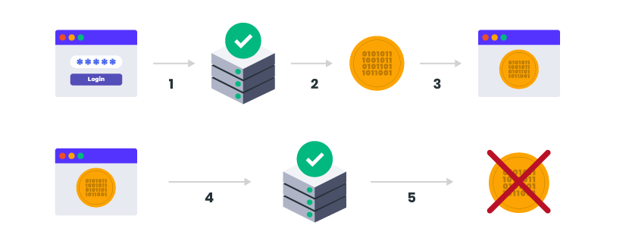
II. Token-Based Authentication
3. How Token-Based Authentication Works

Slide 15
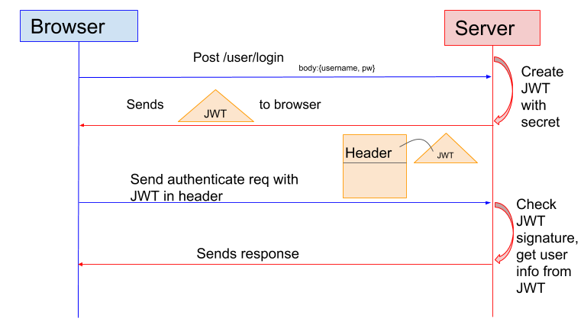
II. Token-Based Authentication
3. How Token-Based Authentication Works

Slide 16
JSON Web Token (JWT)
What is JSON Web Token?
JSON Web Token structure
Some JWT attributes

Slide 17
III. JSON Web Token (JWT)
1. JSON Web Token (JWT)
JSON Web Token (JWT) is an open standard (RFC 7519) that defines a compact and self-contained way for securely transmitting information between parties as a JSON object.
This information can be verified and trusted because it is digitally signed.
JWTs can be signed using a secret (with the HMAC algorithm) or a public/private key pair using RSA or ECDSA.

Slide 18
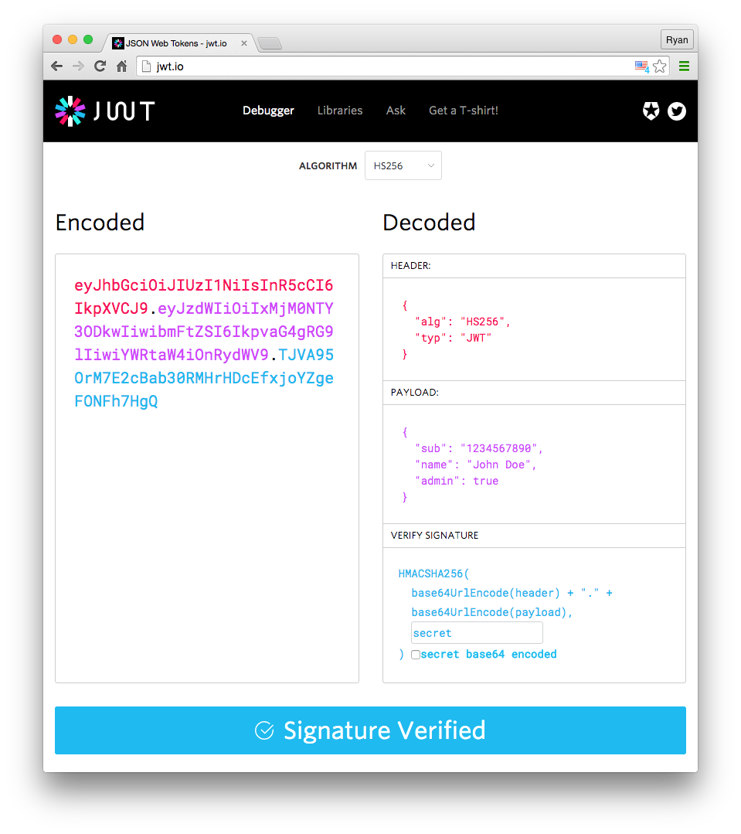
III. JSON Web Token (JWT)
2. JSON Web Token structure
Header
Payload
Signature

Slide 19
III. JSON Web Token (JWT)
3. Some important JWT attributes
Iss: The issuer of the token
Sub: The subject of the token
Aud: The audience of the token
Exp: This will define the expiration date
Nbf: Defines the time before which the JWT MUST NOT be accepted for processing
Iat: The time the JWT was issued. Can be used to determine the age of the JWT
Jti: Unique identifier for the JWT. Can be used to prevent the JWT from being replayed. This is helpful for a one time use token.

Slide 20
Angular Authentication and Authorization
HTTP Interceptors
Router Guards

Slide 21
VI. Angular Authentication and Authorization
1. HTTP Interceptors
Interceptors have been used to pre-process and post-process the HTTP request before sending and after getting response from the server.

Slide 22
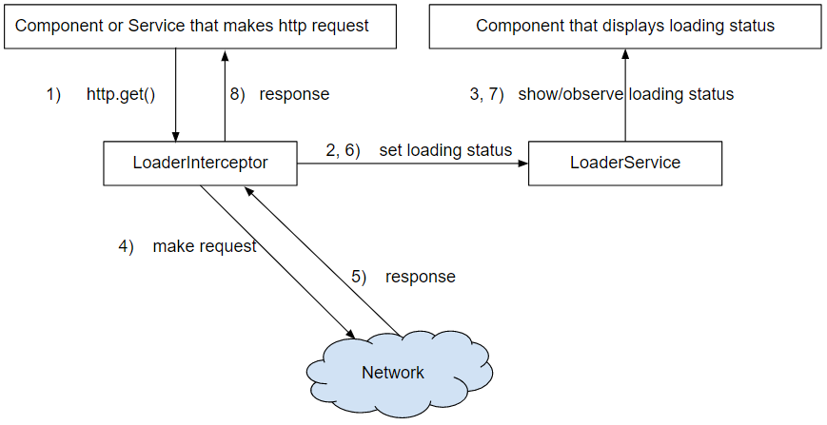
III. Angular Authentication and Authorization
1. HTTP Interceptors

Slide 23
VI. Angular Authentication and Authorization
2. Router Guards
Protect routes
Prevent users form accessing areas that’s not allowed.
Ask them to confirmation when leaving a certain area.

Slide 24
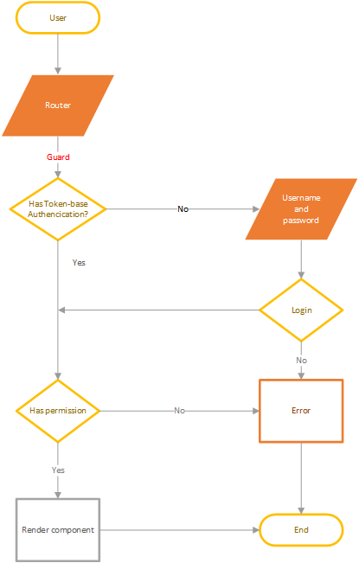
VI. Angular Authentication and Authorization
2. Router Guards

Slide 25
V. Demo

Slide 26
THE END. THANK YOU, EVERYONE.

